Slide 1
AI Agent Frameworks
Dr. Rakhee Chhibber

Slide 2
Agenda
Agentic AI frameworks
– How to use Proprietary Vs Open Source frameworks
– Code based and No-Code based frameworks to build Agentic AI systems
– Building Multi step and Multi agent systems
Agentic AI systems using LangChain, LangGraph, BabyAGI, AutoGPT or Zapier
CAMEL and Swarm intelligence approaches,
Graph & Symbolic Integration,
GraphRAG / KG-RAG → Retrieval over knowledge graphs for better structured reasoning
Neuro-Symbolic AI → Combine neural models with logic/rule-based engines
Semantic Indexing → Embedding-based retrieval enhanced with ontologies or taxonomies

Slide 3
Agentic AI Systems
Building Agentic AI systems involves choosing between code-based frameworks, which offer granular control and high scalability, and no-code platforms, which prioritize rapid prototyping and accessibility for non-technical users.

Slide 4
Code-Based Frameworks
These frameworks typically require Python or JavaScript expertise and are ideal for complex, stateful, or production-grade applications

Slide 5
Code-Based Frameworks
LangGraph: A specialized extension of the LangChain ecosystem that uses a graph-based approach to build stateful multi-agent systems. It excels at complex workflows requiring precise engineering control, such as cyclical or branching logic.
CrewAI: A high-abstraction framework designed to orchestrate "crews" of agents with defined roles, backstories, and tasks. It is frequently cited as the fastest programming framework for multi-agent development.
Microsoft AutoGen: Focuses on autonomous, asynchronous collaboration where agents interact through dynamic conversations. It is highly suited for research, complex simulations, and scenarios requiring multi-agent teamwork.
Semantic Kernel: An enterprise-grade SDK from Microsoft for integrating LLMs into C#, Python, or Java applications. It is preferred for projects requiring strict governance, compliance, and deep integration with existing software stacks.

Slide 6
No-Code & Low-Code Platforms
Flowise: An open-source visual workflow builder that provides modular blocks to assemble anything from simple RAG systems to autonomous agents.
Dify: A popular low-code platform featuring a polished UI for building and managing AI-powered applications without managing backend infrastructure.
n8n: An automation-heavy tool that recently integrated AI agent features, allowing users to blend classic workflow automation with intelligent agents.
Microsoft Copilot Studio: A no-code graphical environment for building agents deeply integrated with Microsoft 365, Azure, and Power Automate.
LangFlow: A low-code visual builder specifically focused on agent workflows and rapid prototyping within the LangChain ecosystem.
Zapier Central: An evolution of Zapier's automation platform that enables users to create AI-powered workflows in plain English, leveraging its ecosystem of over 7,000 integrations.

Slide 7
Introduction
AI agent frameworks are tools and platforms that help developers build intelligent agents capable of performing tasks autonomously, making decisions and interacting with users or systems. These frameworks simplify the development of agent‑based applications by providing components for reasoning, memory and tool integration.

Slide 8
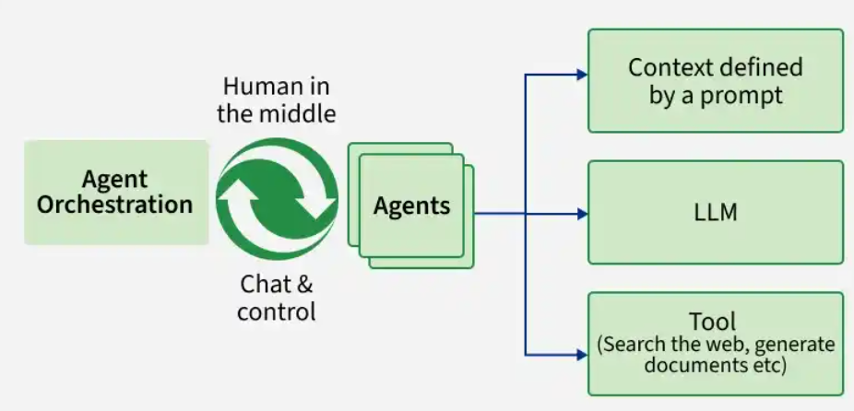

Slide 9
1. LangGraph

Slide 10
1. LangGraph
LangGraph is a framework used to build advanced AI agents that handle complex, stateful workflows. It uses graph-based execution, enabling step-by-step and branching logic for better control over agent behavior.
Workflow Control: Design step-by-step and branching workflows, supporting multi-agent and sequential execution.
Statefulness: Maintains state across steps, allowing agents to track progress and continue tasks smoothly.
Adaptive RAG: Enables context-aware reasoning by integrating retrieval into workflows.
Extensible Design: Easily integrates with LLMs, tools and external systems for custom workflows.
Use Case: Automating support ticket where agent receives input, gathers context and autonomously routes and resolves queries, escalating only when necessary.

Slide 11
Implementation
Install Packages: Install LangGraph and LangChain libraries.
Define Function: Create a function using GPT-4o-mini to generate a motivational quote.
Create Graph: Build a StateGraph with a single node calling the function.
Set Flow: Use the same node as both the start and end point.
Run Graph: Compile and execute the graph to get the output.

Slide 12
List of program
Hello message graph using langGraph.ipynb
langgraph exercise.ipynb
sequential grph using langgraph.ipynb
Conditional Graph using langraph.ipynb
langgraph test.ipynb

Slide 13
2. AutoGen

Slide 14
AutoGen ecosystem
The AutoGen ecosystem is divided into four main components:
AutoGen Studio: A no-code graphical interface for building and testing multi-agent workflows.
AutoGent AgentChat: A simplified API for building conversational single and multi-agent applications.
AutoGen Core: The foundational API for building scalable multi-agent AI systems.
AutoGen Extension: A library of first- and third-party extensions that expand the framework's capabilities.

Slide 15
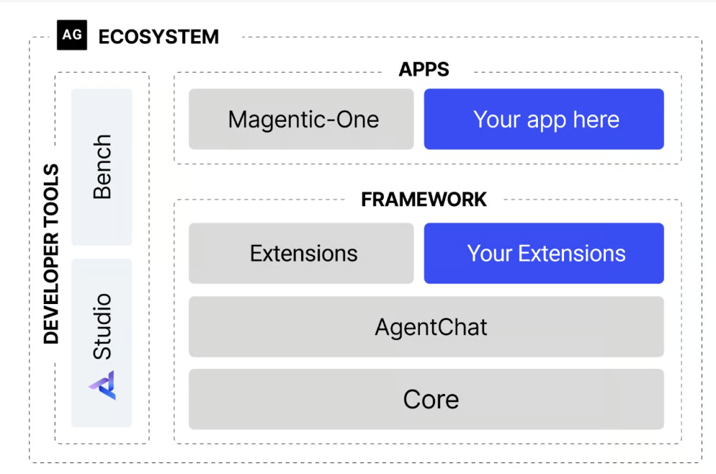

Slide 16
What is AutoGen?
It is a Microsoft-backed framework for building multi-agent systems where AI agents collaborate with each other and humans to automate complex tasks through dynamic conversations.
Multi-Agent Conversations: Enables agents to interact autonomously or with human input for collaboration, debate and problem solving.
Role-Based Agents: Agents can be assigned specific roles, personas and responsibilities.
Flexible Interaction Flow: Supports both fully automated and human-in-the-loop workflows.
Task-Oriented Collaboration: Agents coordinate to break down and solve complex tasks step-by-step.
Use Case: AI agents automatically research and draft a technical report with one gathering data, another summarizing and a human reviewer finalizing the content for accuracy and clarity.

Slide 17
Implementation:
This example shows how to create a simple multi agent interaction using AutoGen with an assistant and a user agent.
Install Package: Install AutoGen from GitHub.
Load API Key: Set up your OpenAI API key for access.
Create Assistant: Define an AssistantAgent using GPT-3.5-turbo.
Create User Agent: Define a UserProxyAgent with no human input.
Start Chat: Initiate a conversation with a starting message and limit it to 2 turns.

Slide 18
List of code
autogen - using open api key.ipynb

Slide 19
3. CrewAI

Slide 20
crewAI
CrewAI is an open-source framework for building teams of AI agents that collaborate with defined roles to solve complex, multi-step tasks such as research, content creation and business workflows.
Role-Based Agents: Agents are assigned roles, goals and backstories for specialized behavior.
Task Coordination: Tasks are defined and distributed among agents for efficient execution.
Collaborative Execution: Multiple agents work together, optionally with human input, to complete complex workflows.
Use Case: Multi-agent systems for generating, vetting and publishing marketing content one agent drafts, another edits, a third handles distribution.

Slide 21
Implementation:
Let's see a code example to understand better:
Import Libraries: Import Crew, Agent and Task and check for the API key.
Create Agents: Define agents like Python Assistant and Philosopher with roles and backstories.
Define Tasks: Assign tasks such as printing “Hello, world!” and explaining the meaning of life.
Build Crew: Create a Crew using the defined agents and tasks.
Execute Tasks: Run the crew to perform tasks in parallel and get results.

Slide 22
List of code
Crewai using Hugging Face.ipynb
crewAI using OpenAPI.ipynb

Slide 23
Semantic Kernel

Slide 24
Semantic Kernel
is an open-source SDK by Microsoft that integrates large language models into existing applications, enabling structured orchestration of AI, code and external services.
AI + Code Integration: Combines traditional programming logic with LLM capabilities.
Orchestration Engine: Coordinates tasks across AI models, APIs and business logic.
Plugin-Based Architecture: Supports extensible functions and connectors for real-world applications.
Enterprise Focus: Designed for scalable, secure and production-ready systems.
Use Case: AI automatically summarizes customer feedback, integrates with business tools and alerts human staff for key issues, all in one workflow

Slide 25
Implementation:
Let's see a code example to understand better:
Install Package: Install Semantic Kernel (version 1.35.3).
Load API Key: Get the OpenAI API key from environment or Colab secrets.
Utility Function: Define a function to format output (e.g., word wrap).
Setup Kernel: Create a Kernel instance and configure the chat completion model.
Connect Service: Attach the LLM client to the Kernel.
Run Prompt: Send a prompt (e.g., generate a poem) to the model.

Slide 26
AI agent frameeork Semantic Kernel using openapi.ipynb
AI agent frameeork Semantic Kernel using higging face.ipynb

Slide 27
5. LangChain

Slide 28
LangChain
is an open source framework that simplifies building applications using large language models by connecting prompts, data, memory and tools into structured workflows.
Tool Integration: Connects with APIs, databases and search engines to enhance capabilities.
Human-in-the-Loop: Supports workflows with human review and intervention.
Agent Workflows: Enables creation of agents that can think, act and collaborate.
LLM Integration: Works with models like OpenAI, Anthropic and Hugging Face.
Memory and Context: Maintains conversation history for better and personalized responses.
Use Case: An AI customer support agent uses LangChain to fetch FAQs from a database, answer user queries with an LLM, log interactions for future context and escalate unresolved issues to a human agent, all in a single automated workflow

Slide 29
Implementation:
Let's see a code example to understand better,
Load API Key: Get the OpenAI API key from environment or Colab secrets.
Install Packages: Install required LangChain libraries.
Define Model: Initialize the LLM (e.g., GPT-4o-mini) with zero temperature.
Create Prompt: Define a prompt template (e.g., ask for a fun fact).
Build Chain: Combine prompt, model and output parser into a chain.
Run Chain: Execute the chain with input like “cats” to generate a response.

Slide 30
langchain.ipynb

Slide 31
crewAI

Slide 32
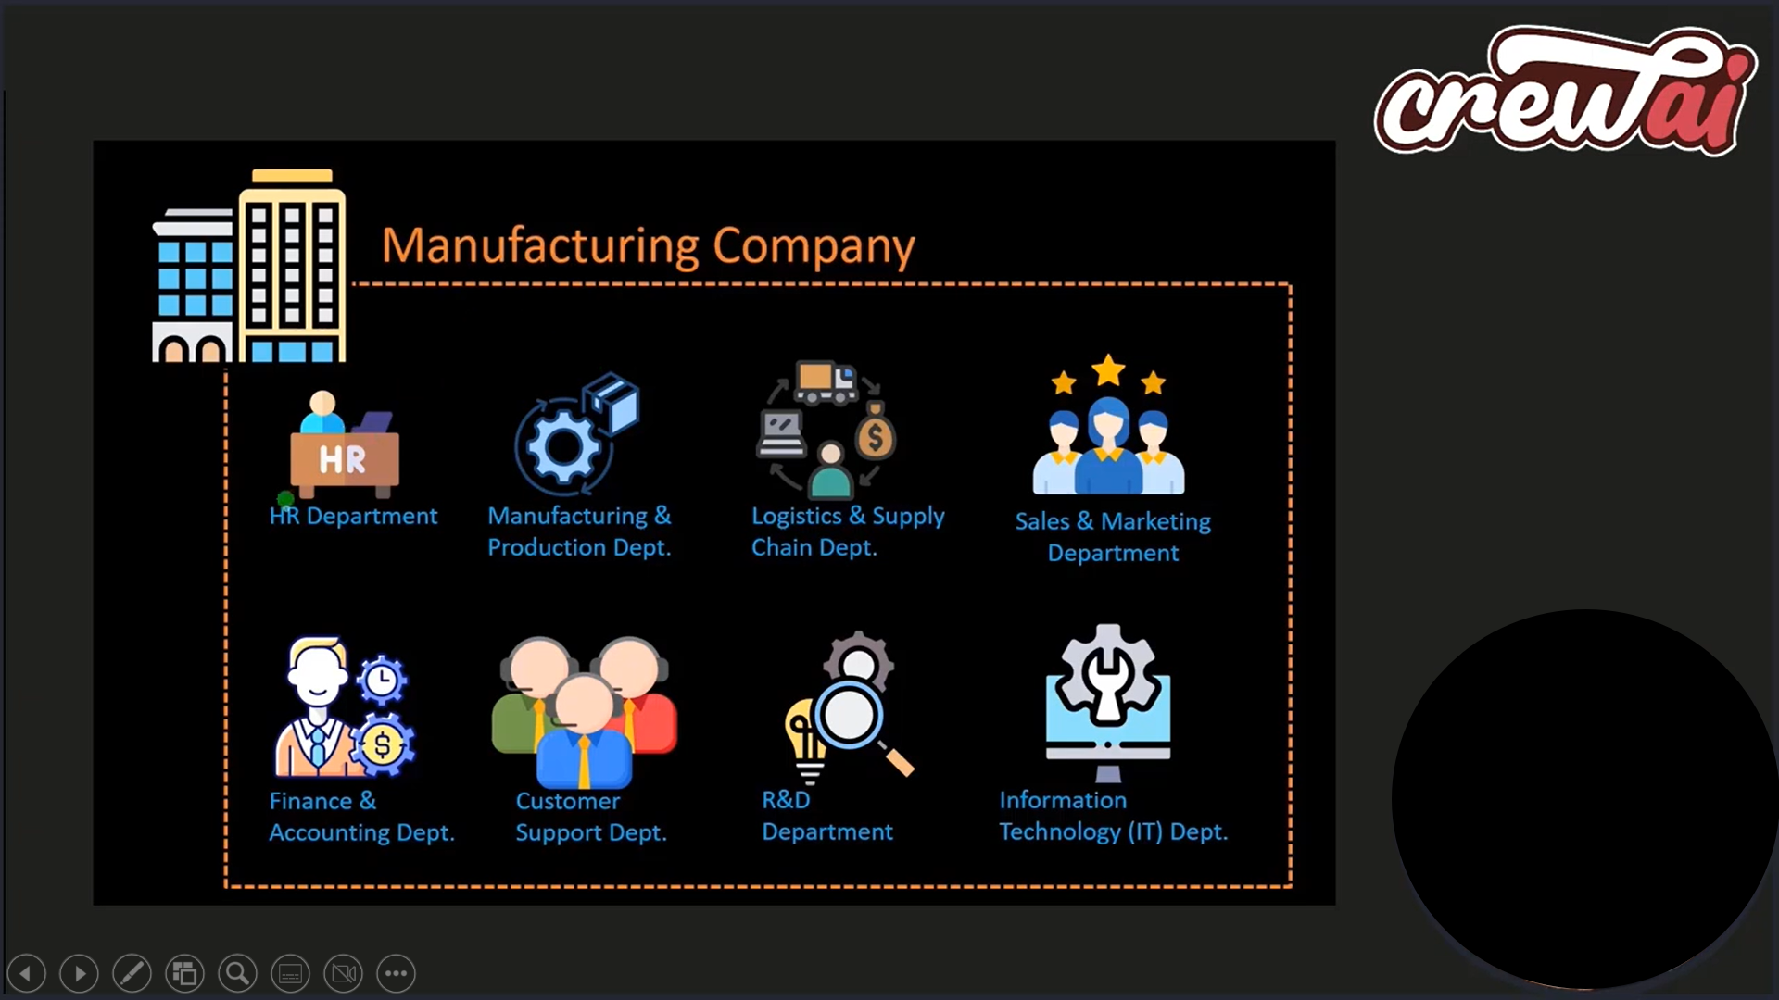

Slide 33
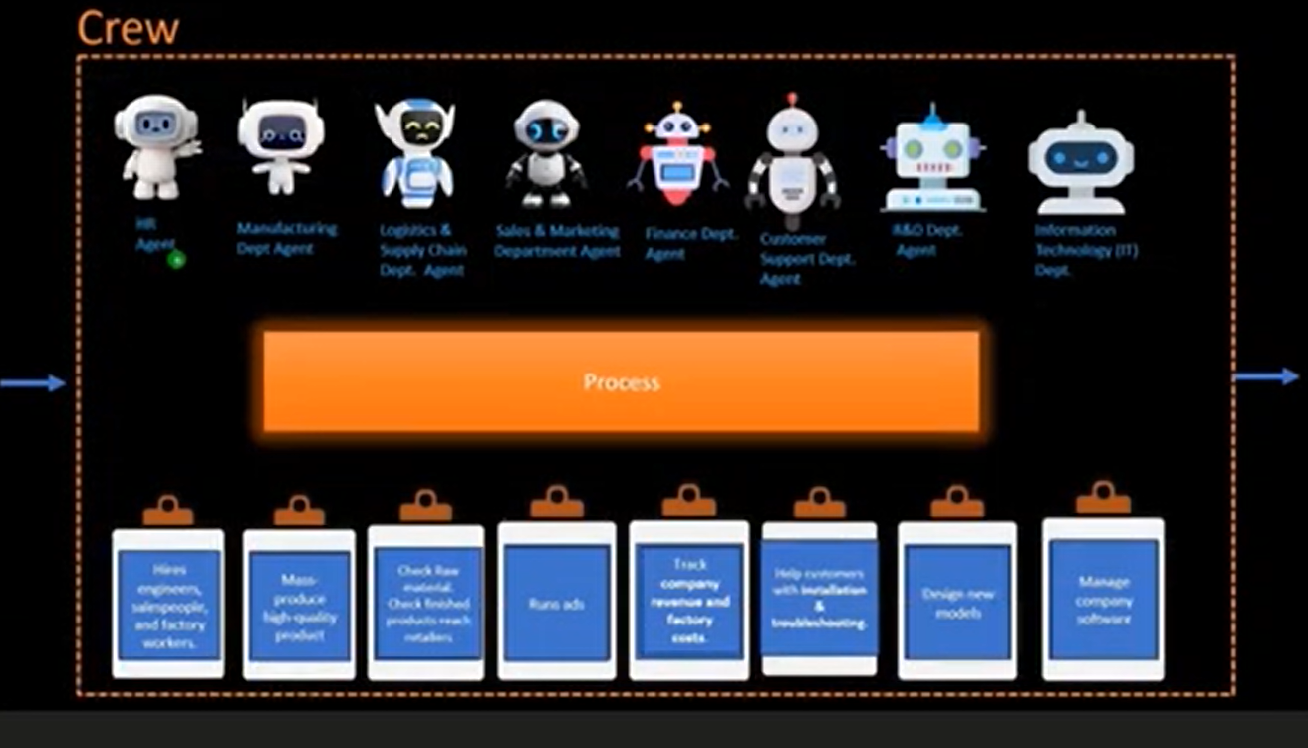

Slide 34
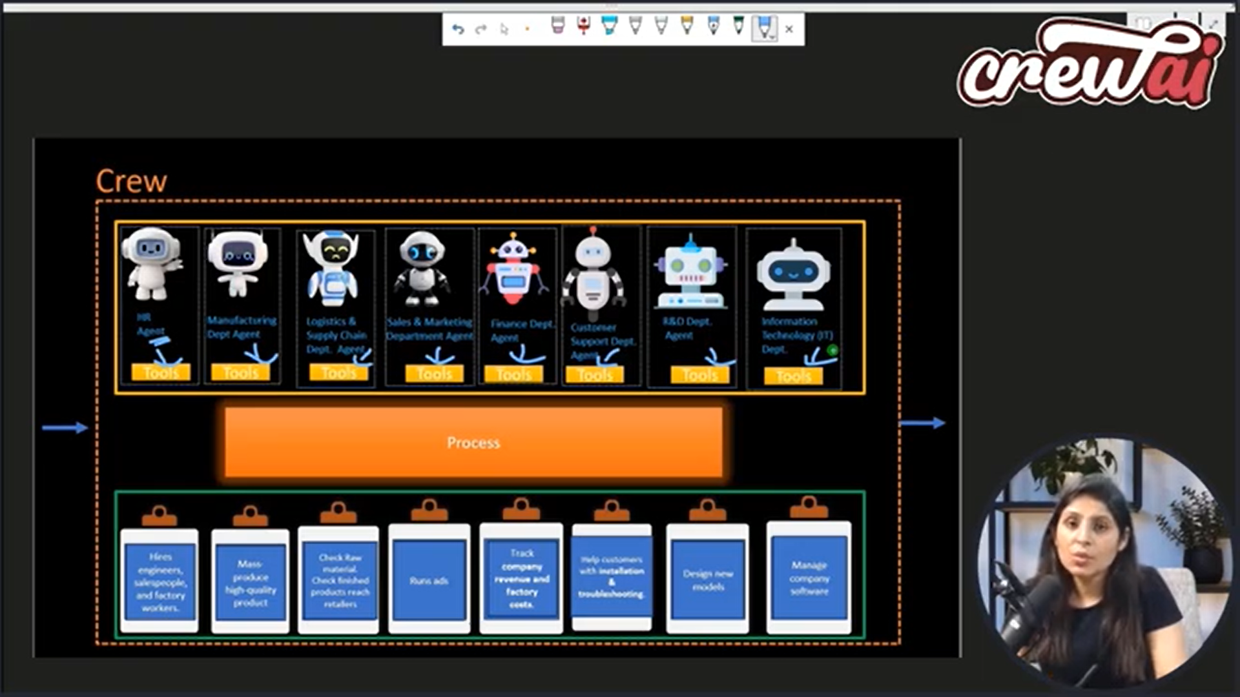

Slide 35
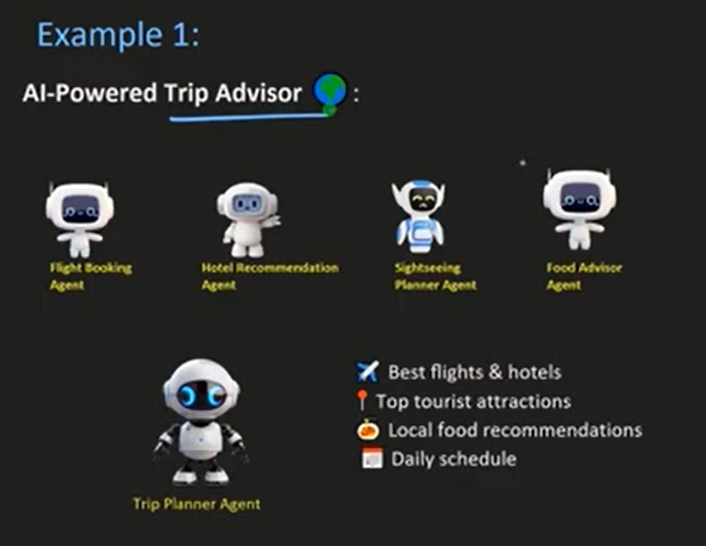

Slide 36
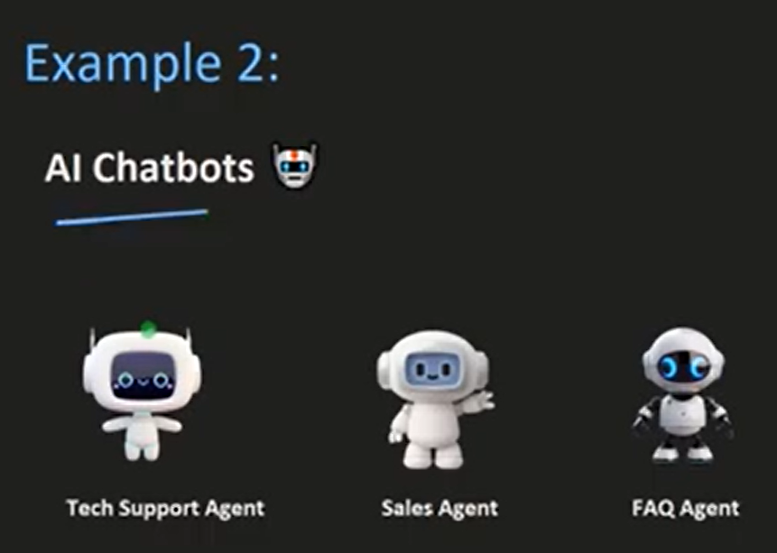

Slide 37
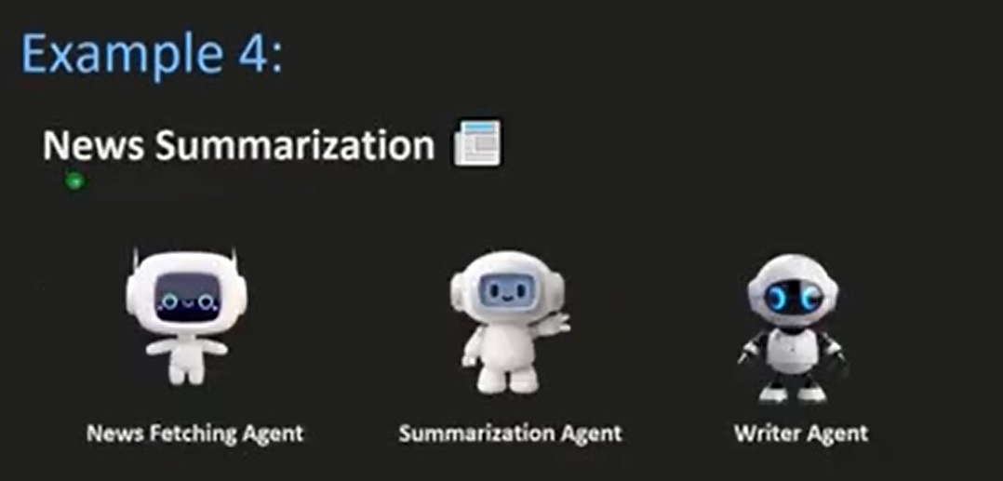

Slide 38
Components of CrewAI
Agents
Tools
Task
And Process

Slide 39
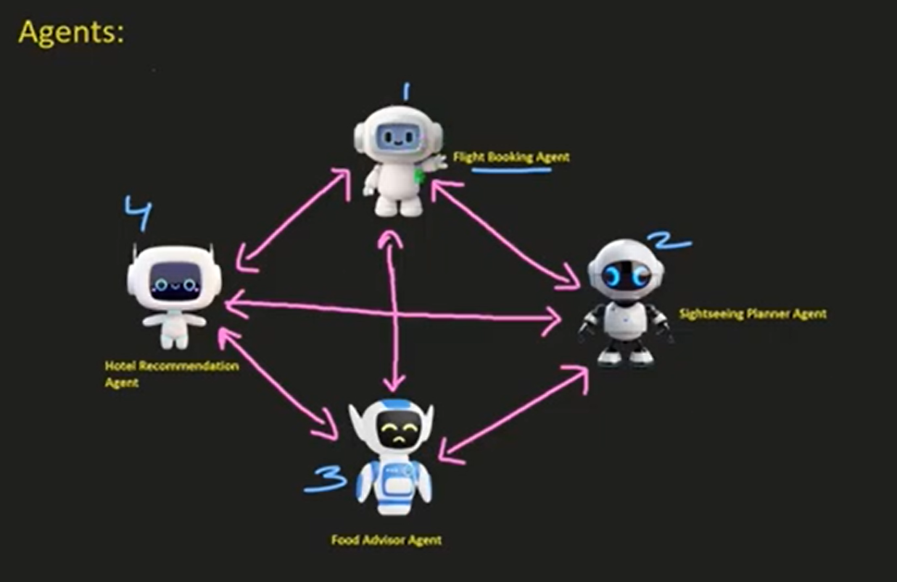

Slide 40
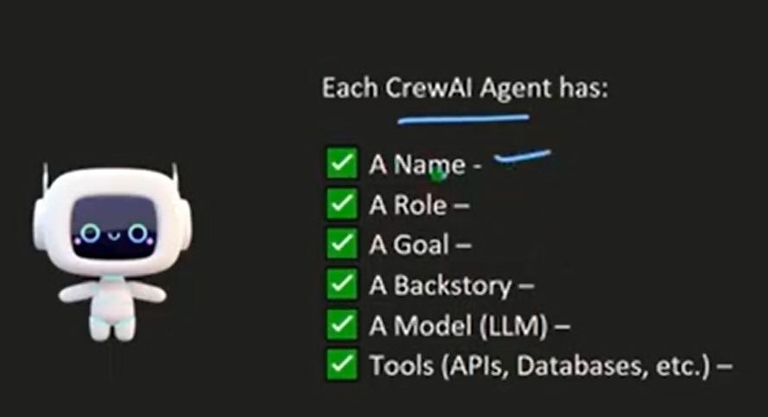

Slide 41
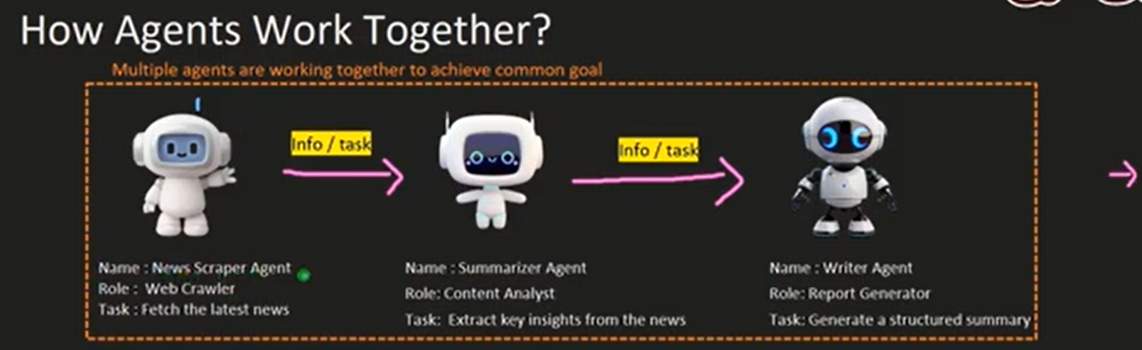

Slide 42
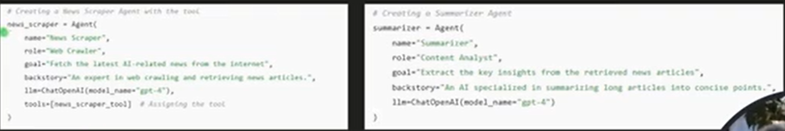

Slide 43
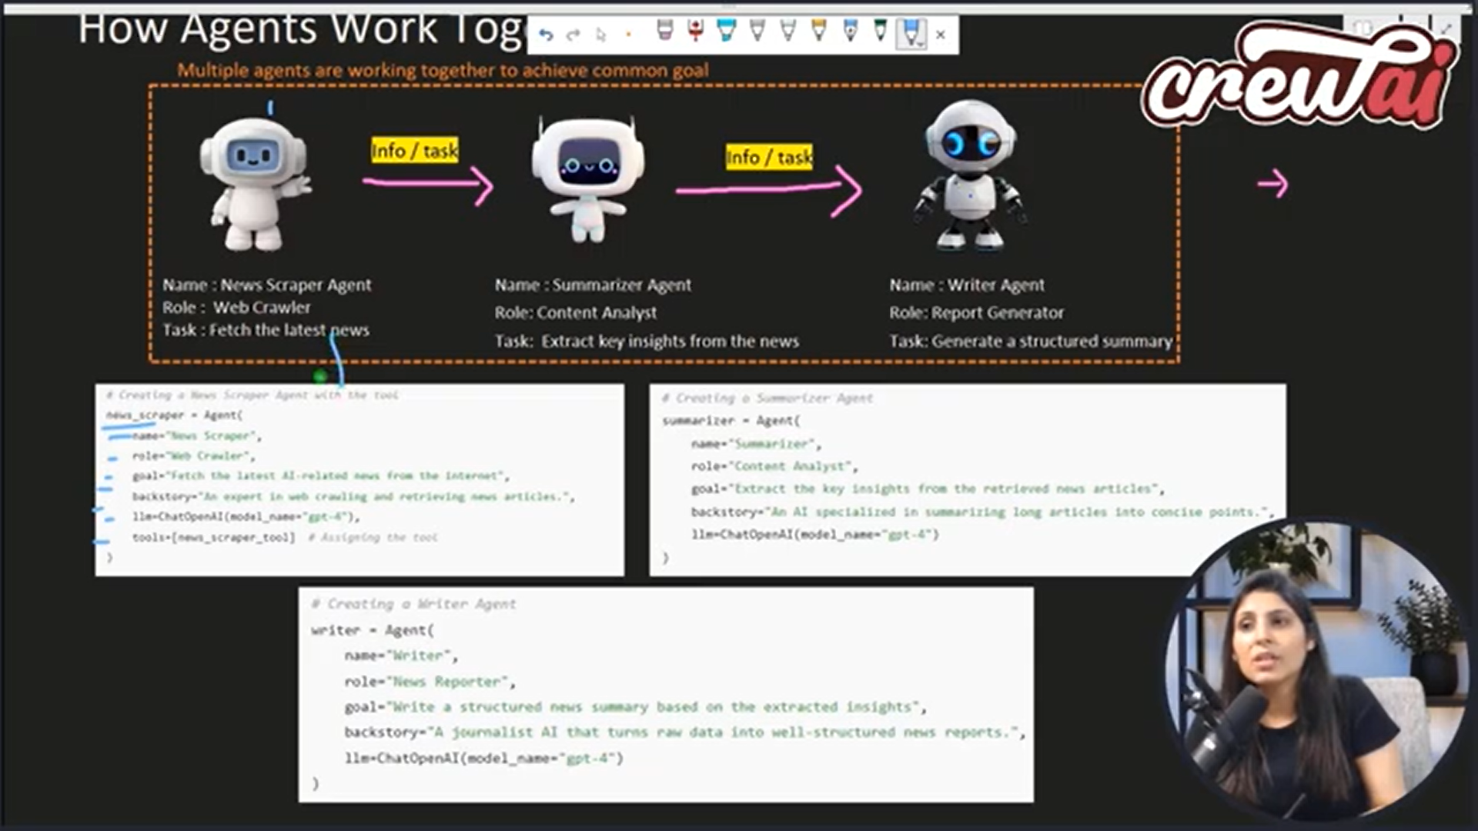

Slide 44
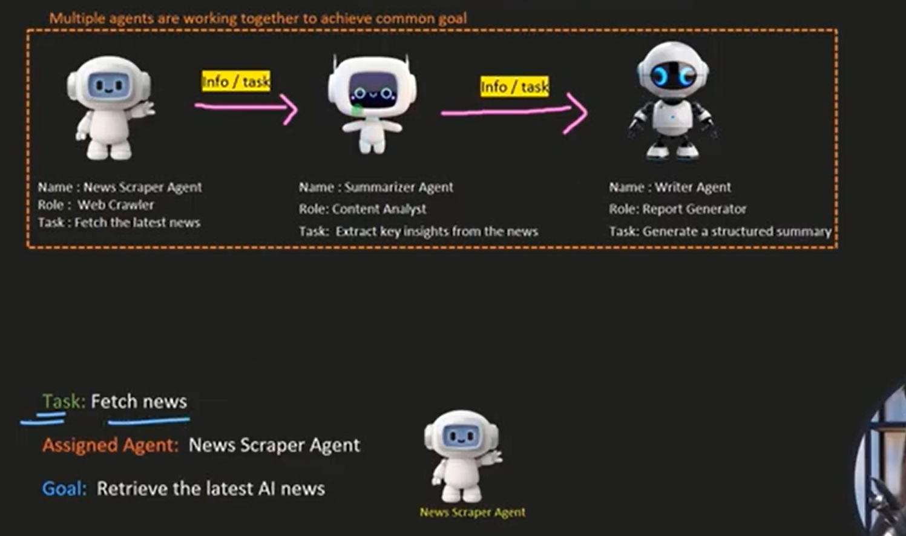
Task allocation

Slide 45
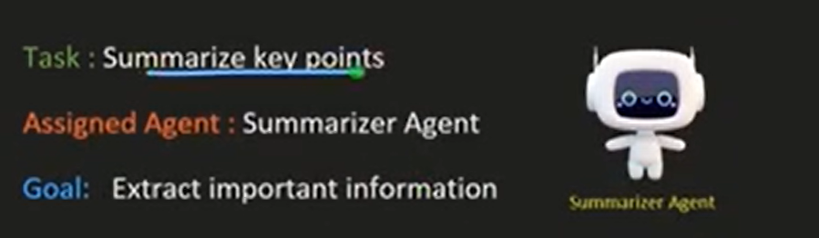

Slide 46
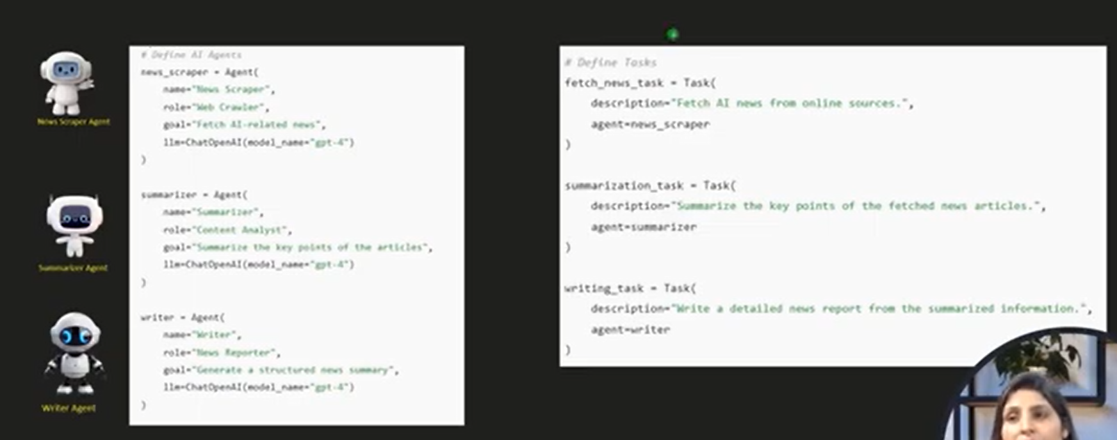

Slide 47
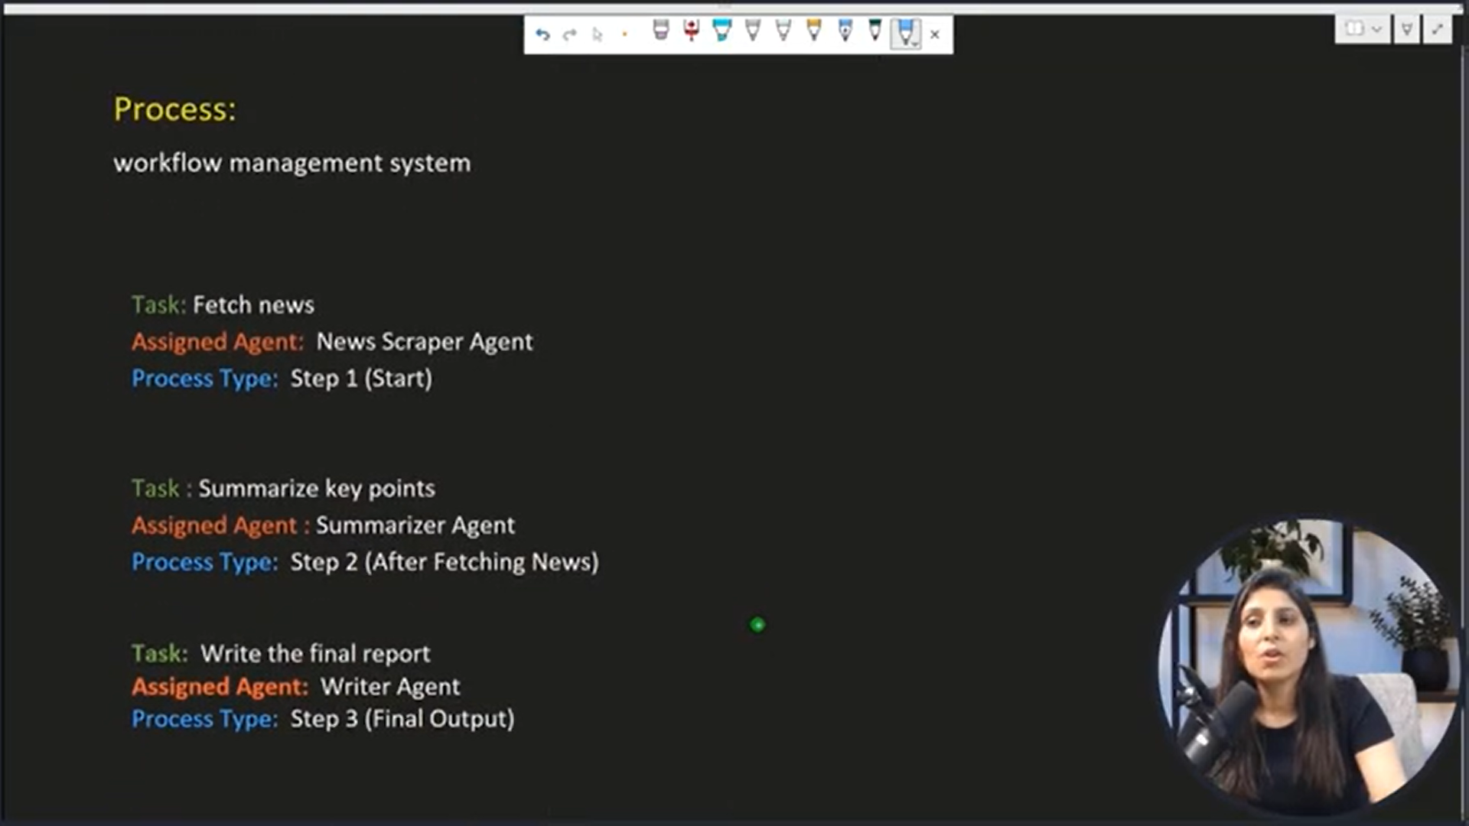

Slide 48
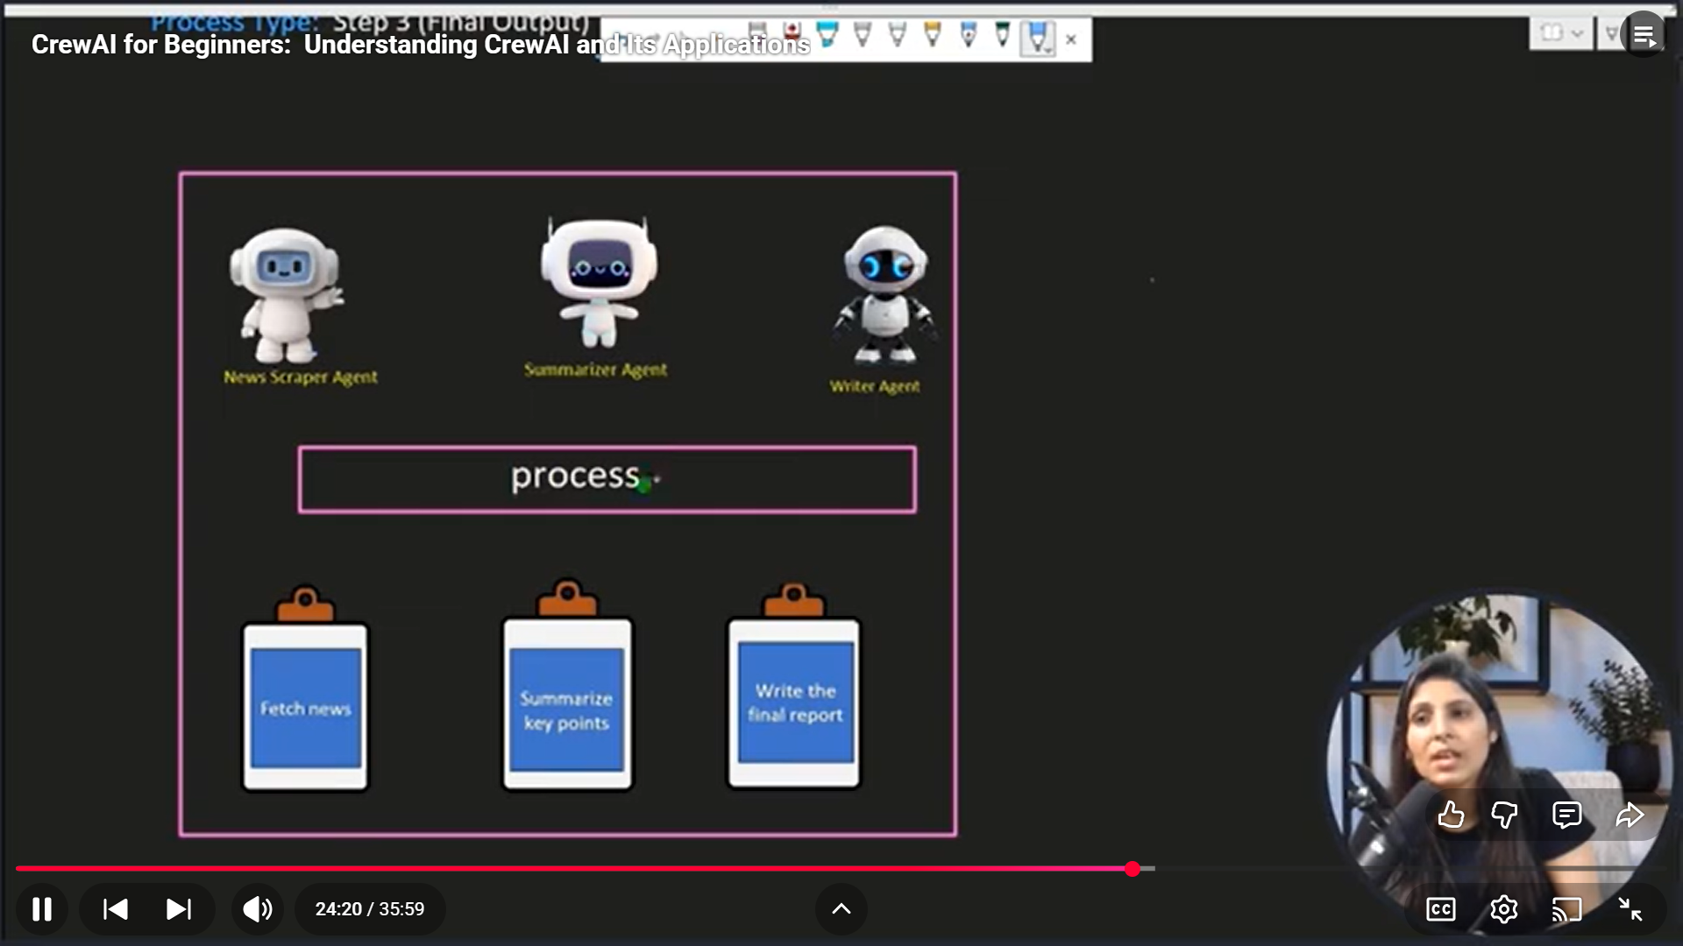

Slide 49
List of code
L-1_crewai.ipynb
L-2 travel agent in google colab.ipynb
https://github.com/codewithaarohi/CrewAI_tutorials/blob/main/L-2/L-2.ipynb

Slide 50
!pip install crewai crewai_tools langchain langchain_community langchain_openai
from langchain.chat_models import ChatOpenAI # Set OpenAI API Key os.environ["OPENAI_API_KEY"] = "s****************v8" # Load LLM Model llm = ChatOpenAI(temperature=0, model="gpt-4o-mini")

Slide 51
from crewai_tools import WebsiteSearchTool
import os
# Instantiate Web Search Tool
web_search_tool = WebsiteSearchTool()

Slide 52
from crewai import Agent
# Create Agents
researcher = Agent( role='Market Research Analyst', goal='Provide up-to-date market analysis of the AI industry', backstory='An expert analyst with a keen eye for market trends.', tools=[web_search_tool], # Only uses web search tool verbose=True )

Slide 53
writer = Agent( role='Content Writer’,
goal='Craft engaging blog posts about the AI industry', backstory='A skilled writer with a passion for technology.', tools=[], # No tools needed; writes based on research summary verbose=True
)

Slide 54
from crewai import Task, Crew
# Define Tasks
research = Task( description='Search the web for the latest AI trends and provide a summarized report.’,
expected_output='A summary of the top 3 trending developments in AI with insights on their impact.’,
agent=researcher )

Slide 55
write = Task( description='Write an engaging blog post about the AI industry based on the research analyst’s summary.', expected_output='A well-structured, 4-paragraph blog post in markdown format with simple, engaging content.', agent=writer, output_file='blog-posts/new_post.md' # Saves blog post in 'blog-posts' directory )

Slide 56
# Assemble the Crew
crew = Crew( agents=[researcher, writer], tasks=[research, write], verbose=True, planning=True # Enable AI planning feature )
# Execute the Tasks
crew.kickoff()

Slide 57
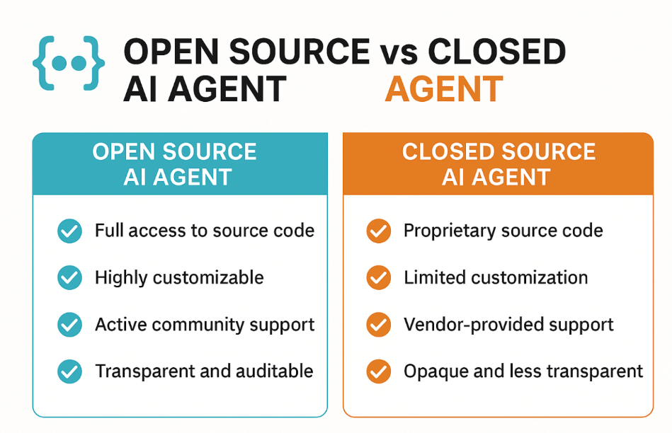
Open-Source vs Closed Source AI Agents:

Slide 58
What Is an Open-Source AI Agent?
An open-source AI agent is one whose source code is publicly available. Developers can view, use, modify, and distribute the code under a license like MIT, Apache, or GNU.
Examples:
LangChain
Auto-GPT
Rasa (for conversational AI)
OpenAssistant

Slide 59
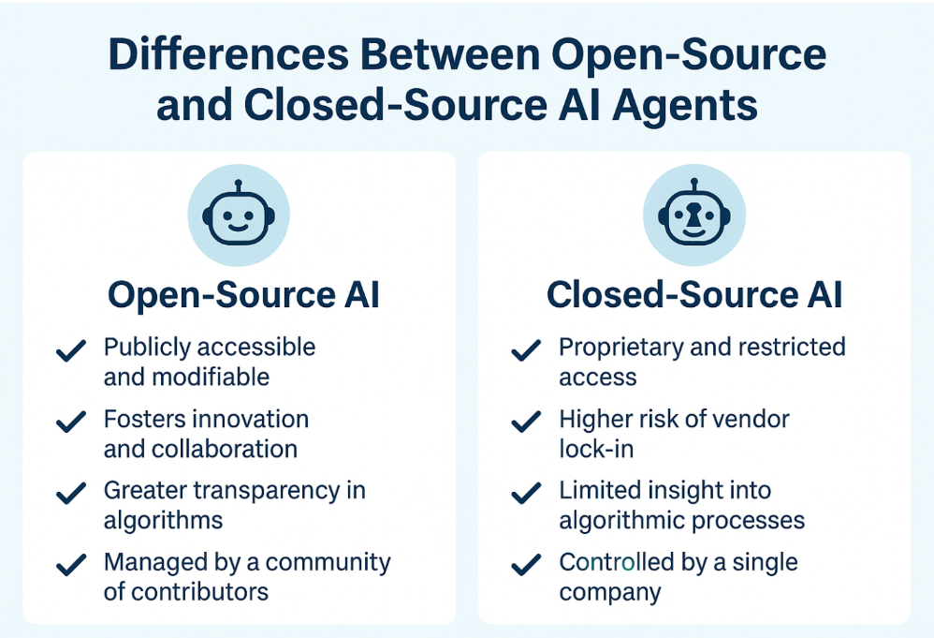

Slide 60
What Is a Closed Source AI Agent?
A closed source AI agent is proprietary. The code is owned by an individual or organization and is not accessible to the public. Users interact with the system via APIs or platforms but cannot inspect or alter the underlying algorithms.
Examples:
ChatGPT (OpenAI)
Bard (Google)
IBM Watson
Microsoft Copilot

Slide 61
Advantages of Open-Source AI Agents
Full Control: Modify the agent’s behavior to suit specific needs.
No Vendor Lock-in: Greater freedom in deployment, migration, and upgrades.
Transparency: You know exactly how decisions are made.
Innovation-Friendly: Rapid experimentation and iteration.
Cost-Effective: Minimal licensing costs.

Slide 62
Disadvantages of Open-Source AI Agents
Requires Technical Expertise: Setup, customization, and support often require skilled developers.
Maintenance Overhead: You’re responsible for updates, bug fixes, and security.
Inconsistent Documentation: May lack enterprise-level guidance or training materials.

Slide 63
Advantages of Closed Source AI Agents
Ease of Use: Often comes with user-friendly dashboards, APIs, and integrations.
Vendor Support: SLAs, customer support, and frequent updates.
Performance Optimized: Enterprise-ready with scalability and robustness.
Focus on Results: Spend less time building and more time delivering value.

Slide 64
Disadvantages of Closed Source AI Agents
Limited Customization: You can only use what the vendor provides.
Data Privacy Concerns: Less visibility into how data is used or stored.
Cost: Can be expensive, especially at scale.

Slide 65
Autogen tutorial
https://www.datacamp.com/tutorial/autogen-tutorial

Slide 66
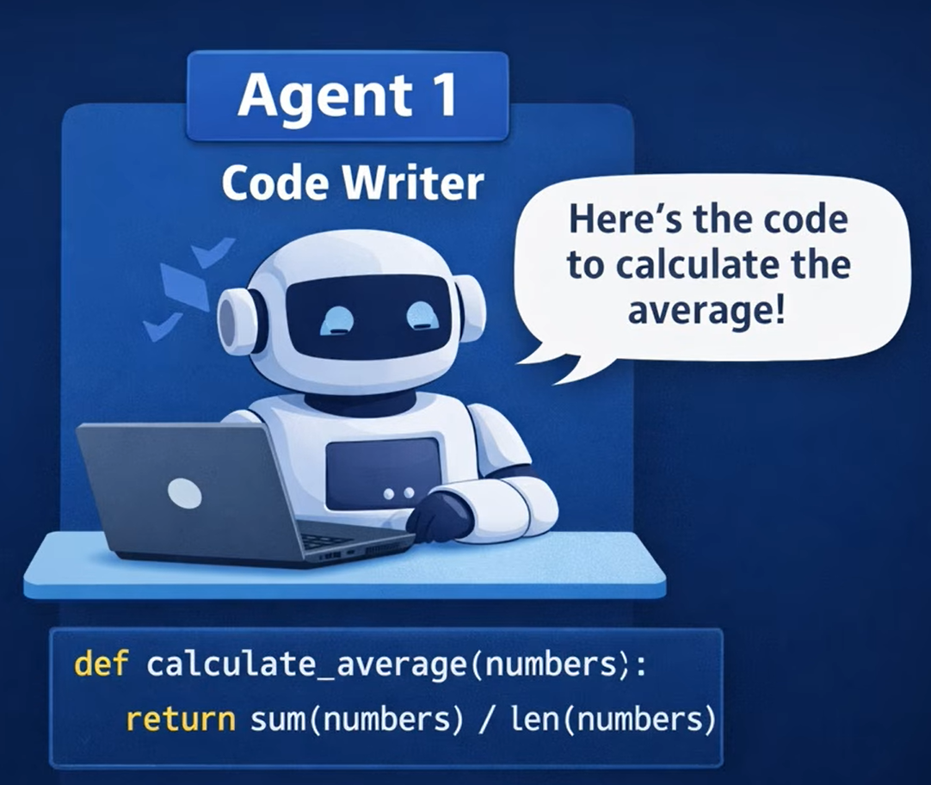

Slide 67
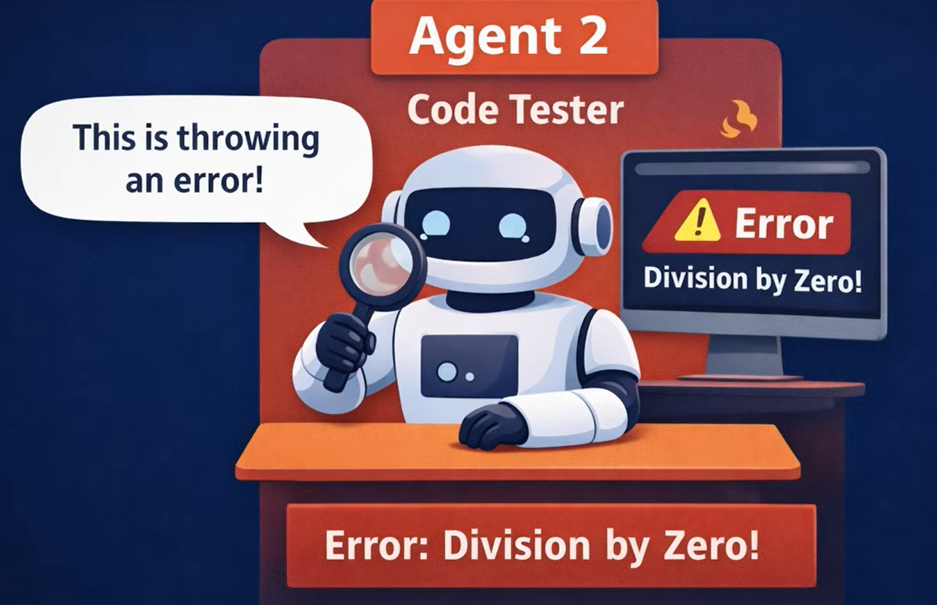

Slide 68
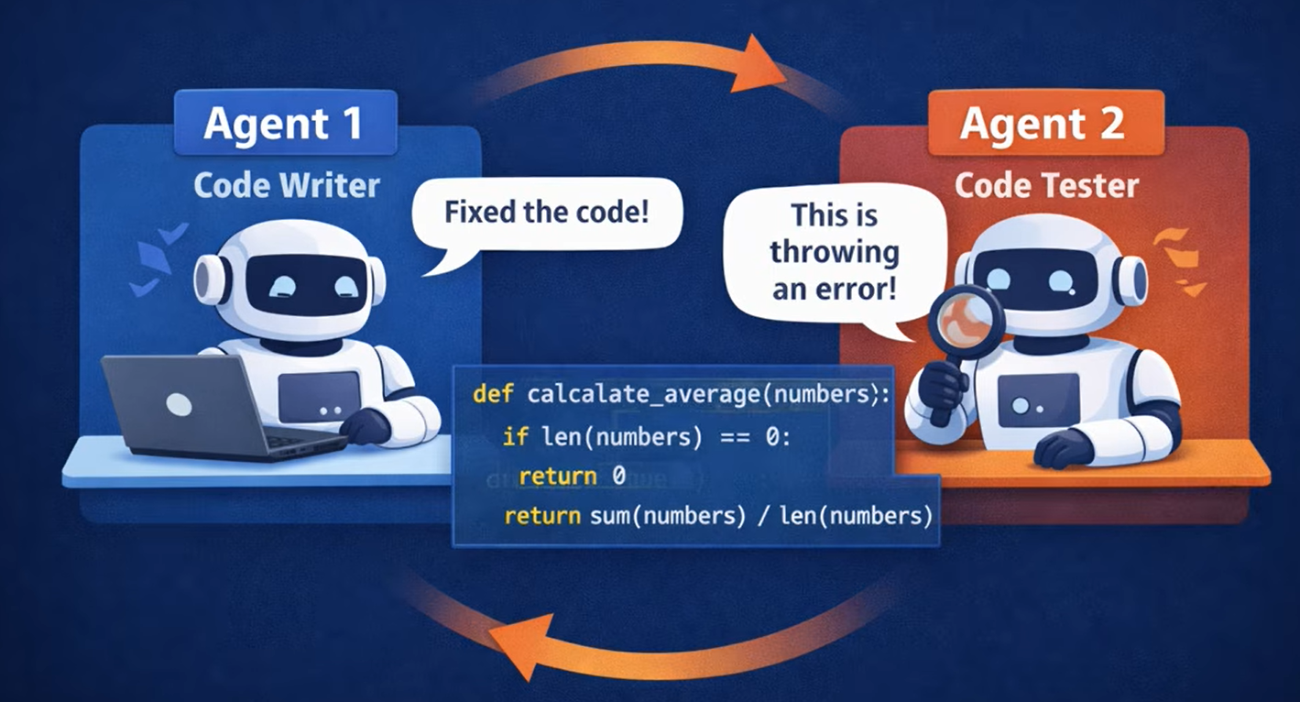

Slide 69
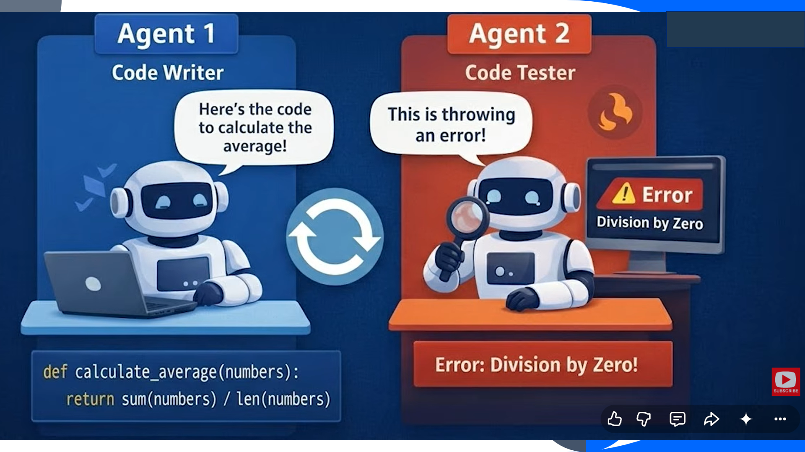

Slide 70


Slide 71
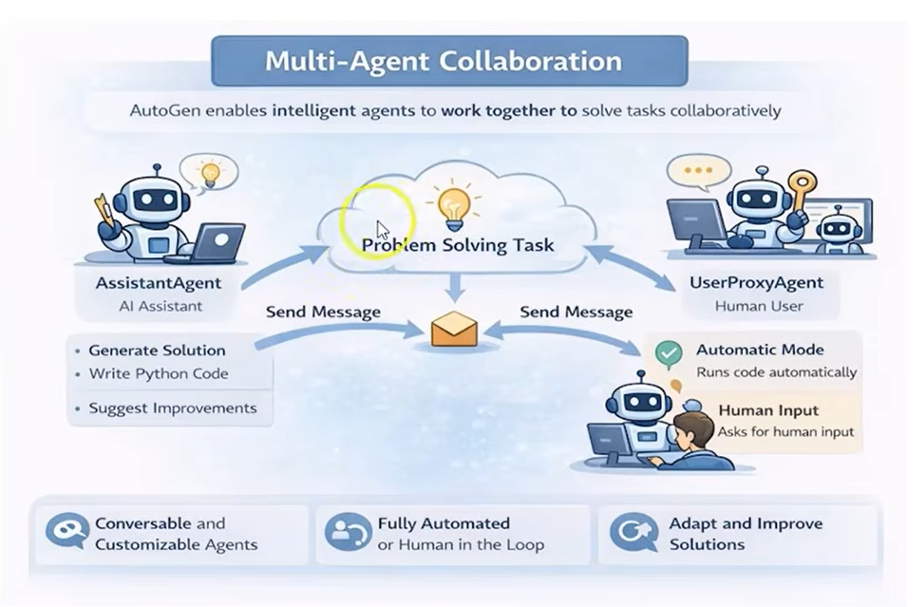

Slide 72
Thank you
Dr. Rakhee Chhibber

